Slide 1
10 INSIGHTS
IN CASHBOX MAGAZINE RECORD (2000-2009)

Slide 2
68% of songs never make the Top 10.
Never-Top10 ratio changes over time
As time approaches 2009, the proportion of Never-top10 tends to decrease.
This shows that people's preferences have begun to spread and the range of change has increased.

Slide 3
The Top 10 songs of 2000-2009
Song Title | Artist | Total Points
GLAMOROUS | FERGIE featuring LUDACRIS | 1335
BEFORE HE CHEATS | UNDERWOOD, CARRIE | 1192
NO SUCH THING | MAYER, JOHN | 1167
CITY LOVE | MAYER, JOHN | 1167
VIDEO | INDIA.ARIE | 1129
WHERE IS THE LOVE? | BLACK EYED PEAS featuring JUSTIN TIMBERLAKE | 1111
TWO WEEKS FROM TWENTY | YELLOWCARD | 1111
AMERICAN BOY | ESTELLE featuring KANYE WEST | 1072
TIME OF YOUR LIFE (GOOD RIDDANCE) | GREEN DAY | 1040
SOMEONE TO CALL MY LOVER | JACKSON, JANET | 1012

Slide 4
JANET JACKSON spent the most weeks(39) at Top 1.
Song Title | Weeks at Top 1
SOMEONE TO CALL MY LOVER | 10
ALL FOR YOU | 10
DOESN'T REALLY MATTER (from "NUTTY PROFESSOR") | 8
FEEDBACK | 6
SPECIAL | 3
LUV | 2

Slide 5
"NO SUCH THING" spent the most weeks at Top 1.
Artist
JOHN MAYER
Song Title
NO SUCH THING
Debut Date
2002-05-26
Weeks at Top 1
13

Slide 6
"SOMEONE TO CALL MY LOVER" peaked at Top 1 the quickest.
Artist
JANET JACKSON
Song Title
SOMEONE TO CALL MY LOVER
Debut Date
2001-07-22
Weeks to Reach Top 1
2

Slide 7
"BEFORE HE CHEATS" took the longest to reach Top 1.
Artist
CARRIE UNDERWOOD
Song Title
BEFORE HE CHEATS
Debut Date
2006-11-05
Weeks to Reach Top 1
31

Slide 8
GROUP VS SOLO in Top 1 & Top 10
GROUP
92
SOLO
84
GROUP
318
SOLO
255
Top 1
Top 10

Slide 9
0.47 is the correlation between weeks at Top 1 & weeks on the chart
Weeks at Top 1 VS Weeks on the Chart
There is a certain degree of positive correlation between weeks at Top 1 and week on the chart, but the degree is not obvious.

Slide 10
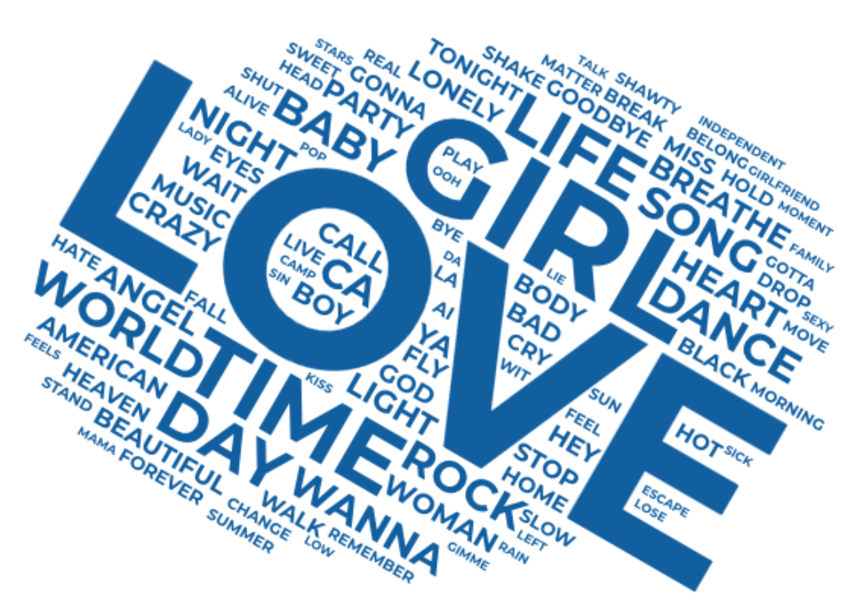
The Most Used Words in Titles
word | number
LOVE | 87
GIRL | 43
TIME | 29
LIFE | 21
DAY | 20
WORLD | 15
BABY | 14
DANCE | 14
ROCK | 14
SONG | 14
… | …

Slide 11
43% of words in title are Positive
Sentiment Distribution of Words in Title
Based on the sentiment analysis of the words in the title, there are more positive words than negative words, but the difference is not very significant.

